Slide 1




VITB - JHU Health Hack 2025
Improving Health Through Accessible and Empowering Innovation
Problem Statement Title : | LifeBlink : "Smart Eyewear for Communication and Health Monitoring in Speech-Impaired Individuals"
Theme : | Wearable Assistive Devices Enabling Remote Monitoring
Category : | Hardware and Software
Team Name : | LifeBlink
University Name : | Indian Institute of Technology, Indore (in assisstance with Charak Center for Digital Healthcare, IITI Drishti CPS Foundation)
Organized by: VIT Bhopal University and John Hopkins University, USA
1

Slide 2

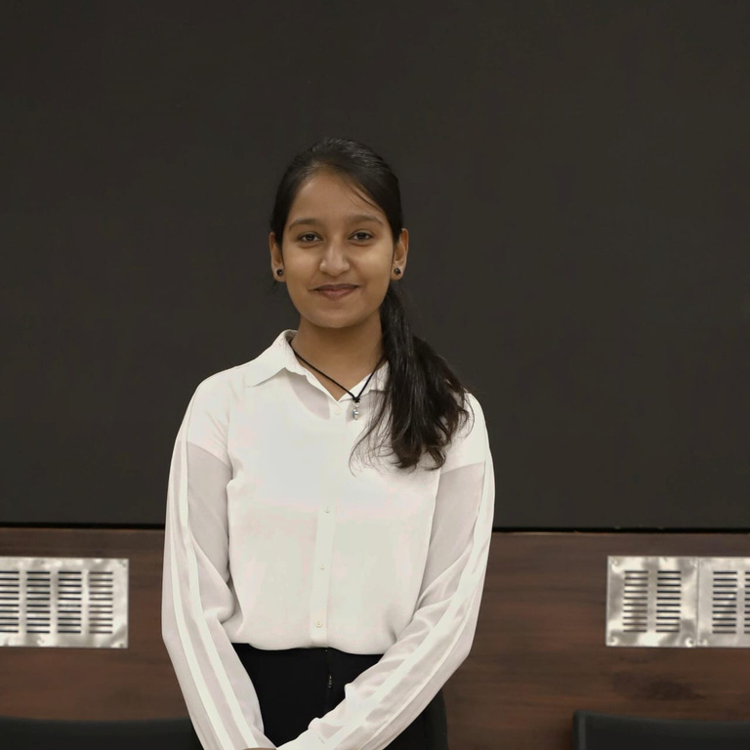

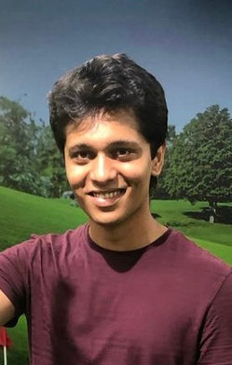
Introductions
Vaidehi Bhat
2nd Yr Electrical Engineering, BTech IIT Indore
Lavanya Bhatnagar
2nd Yr Mechanical Engineering, BTech IIT Indore
Harshvardhan Chaudhary
2nd Year Electrical Engineering, BTech IIT Indore
Yash Bhamare
1st Year Mathematics and Computing, BTech IIT Indore
2

Slide 3

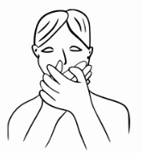




3

Slide 4
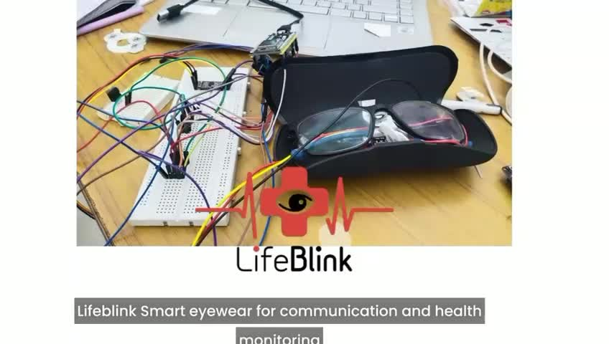
Video
4

Slide 5
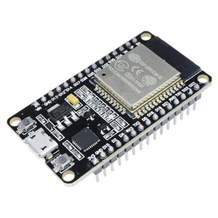

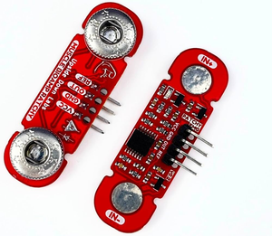


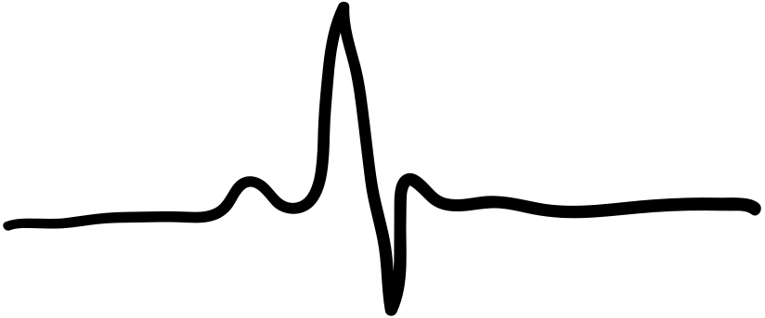
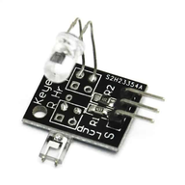




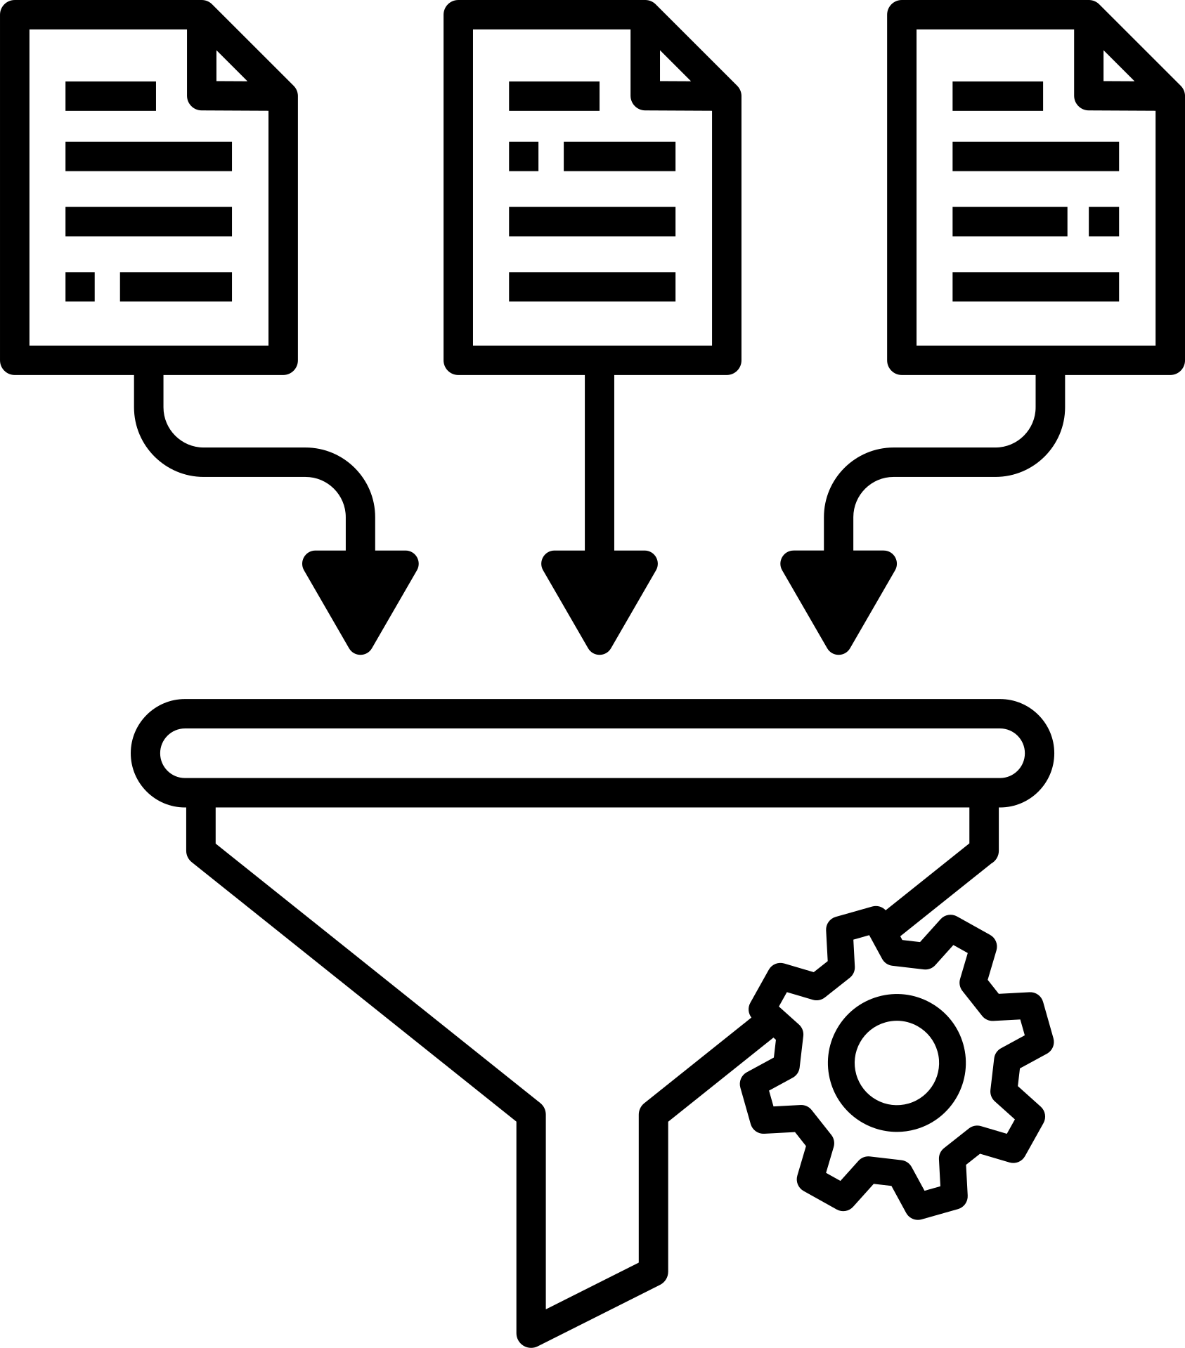








Technical Implementation and Integration
Electrooculography (EOG) Sensors
Bio-Amp EXG Pill
Obtaining Heart Rate
Obtaining Blink Count
Microcontroller:
ESP32
Photoplethysmography(PPG)
Sensors
KY-039 HeartBeat Sensor
Translating Blink Count to Audio Output: Thresholding for Emergencies
Data Collection
Obtaining Results
PPG Data Filtering
Butterworth Bandpass Filters
IIR Notch Filters
Pywavelet’s Denoising
Data Processing
Flask Used: Render
Lightweight Python Framework for hosting Web Application and API calls from ESP32
EOG Data Filtering
Data Handling on Server
Saving Data
32 GB SD Card
Code Description
Offline Saving
Deployed Via: GitHub
Interoperability
Signal Processing
Signal Trimming
Dynamic Peak Counting
Online Dumping
5
Directly On Server

Slide 6
Technical Implementation and Integration
Timing and Workflow
3 Second Countdown
8 Second EOG Data Collection
Dumped on SD Card with date time, Read from SD Card, Sent over to Render
20 Second PPG Data Collection
Delay of 10 Seconds
Return of Results
Dumped on SD Card with date time, Read from SD Card, Sent over to Render
Return of Results
Completion of One Cycle and Start of Another
6

Slide 7
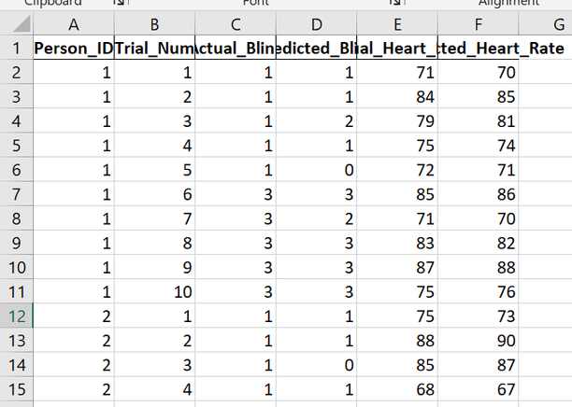
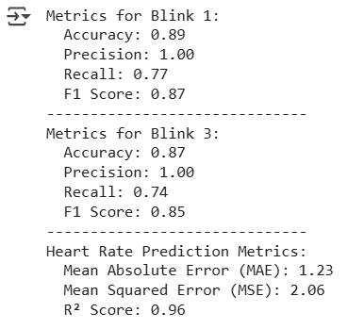
Performance of the Product
To evaluate the performance of the device, we ran tests over 8 subjects and created a database for 7 of them. Each person took 10 trials, 5 for each of two activities of blink count, i.e. blink_count=1 and blink_count=3, simultaneously heart rate was monitored as well and verified from a smart watch placed on the same location(STA) as the PPG sensor of LifeBlink spectacles.
Metrics for Blink : 1
Accuracy: 0.89
Precision: 1.00
Recall: 0.77
F1 Score: 0.87
Metrics for Blink : 3
Accuracy: 0.87
Precision: 1.00
Recall: 0.74
F1 Score: 0.85
Results:
Heart Rate Prediction Metric:
Mean Absolute Error (MAE): 1.2
Mean Squared Error(MSE): 2.06
R Score: 0.96
2
7

Slide 8
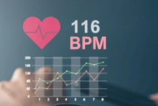

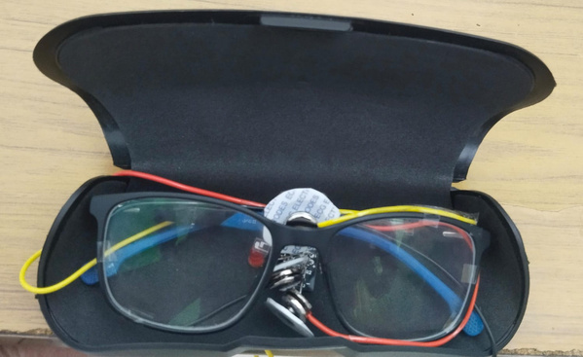

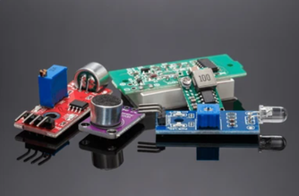



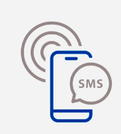

Impact and Potential Benefits
Two- layered emergency alert
  Voluntary - Blinking
  Involuntary - Heart rate monitoring
  alerts emergency even if blinking not feasible for the patient
Easy to Wear
Portable
User Experience
Robust Functionality
Remote Monitoring
  Audio Output
  Alert on caretaketr’s device
Inexpensive sensors
Minimal maintainence
Improved Efficiency in patient monitoring
Affordability
8

Slide 9
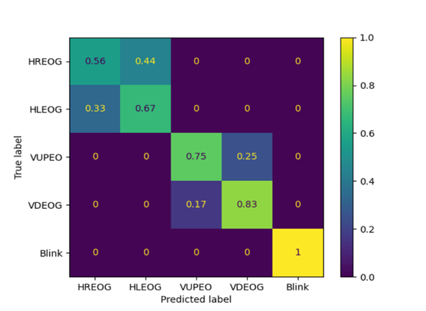
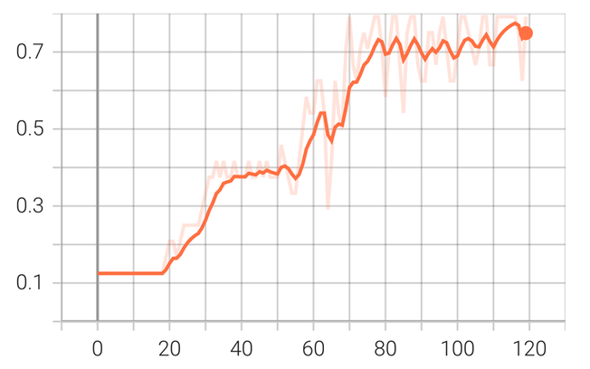
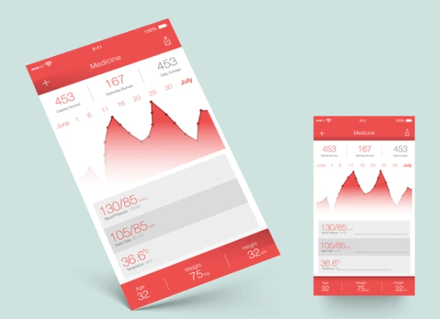
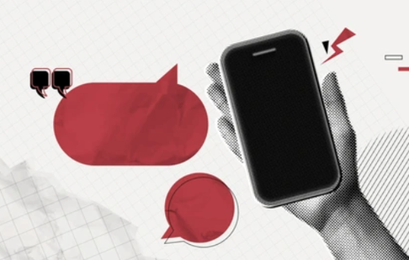
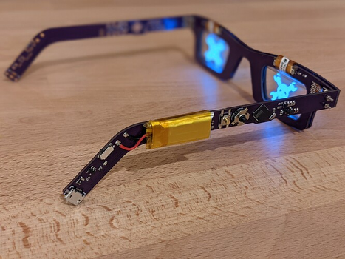
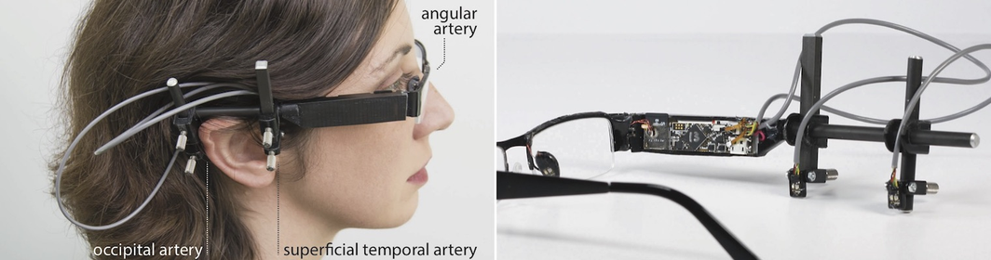
Scalability
Expanding the vocabulary
App for Holistic Monitoring
Detection of more eye gestures
Developing Mobile Application
  Successful attempt at detecting the horizontal and vertical extremes i.e. Left, Right, Up and Down eye movements along with blink detection.
  Allows to create multiple command combinations, hence enhanced communication
  Caretakers receive commands generated from blink detection in form of push notification and audio messages
  Real time heart rate data monitoring feature in the app
  Allowing multiple users (caretakers) for a single patient’s data
Confusion Matrix for the 5 classes
Left Right, Up, Down, Blink
After training the model, we obtain 76% accuracy on Validation set
Custom PCB Integration
Integrating PCB within the frame
  Customizing PCB for sensors and power supply from rechargeable battery
  Sleek, wire free spectacles design by Integrating the PCB within eyewear frame
Image source :
www.christianholz.net/glabella.html
9

Slide 10
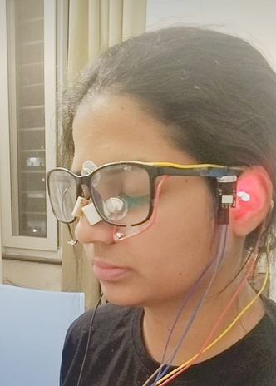

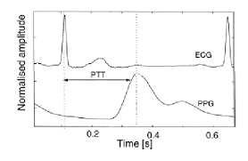
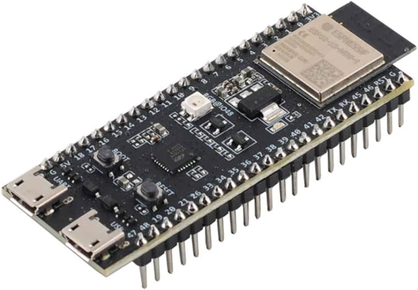
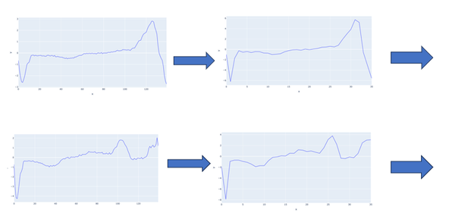
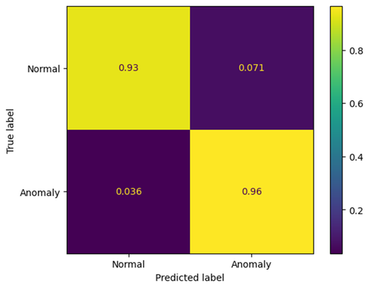
Scalability
Angular Artery
Superficial Temporal Artery
Occipital Artery
Blood Pressure Monitoring
Using Pulse Transit Time Calculation
3 PPG sensors provide Heart Rate data from 3 location
  Pulse Transit Time (PTT) algorithm can be used over heart rate data received from non contact PPG sensors to calculate Blood Pressure
PPG sensor locations
PTT algorithm employed between the data received from these 3 locations
Additional Core in MCU
For simultaneous data collection
  Currently: ESP 32 uses dual core to receive data from sensors and process them one at a time
  Extra core would allow data processing from multiple sensors simultaneously and accurately
Image source: ResearchGate | Alan Mathewson
Anomaly Detection
Normal vs Anomaly in Heart Rate
94% accuracy obtained
Utilizing Heart Rate data to detect threats to health
Normal
  Leveraging data from the PPG sensors, anomaly detection algorithms are developed to identify and alert the patient about any upcoming health threats or abnormal heart rate behaviour
Anomaly
10

Slide 11


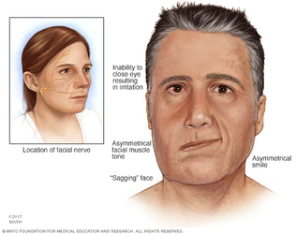

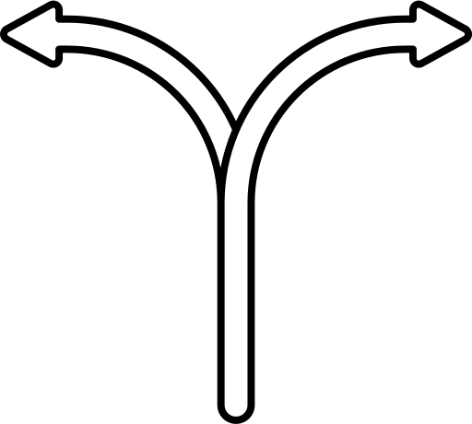
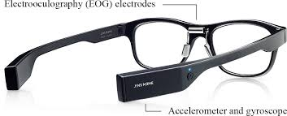
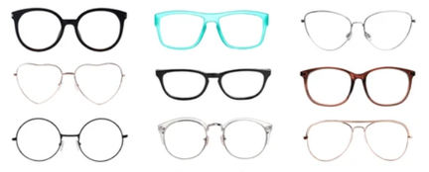

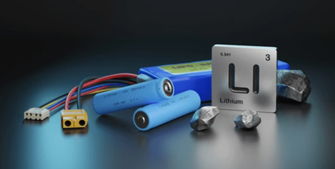
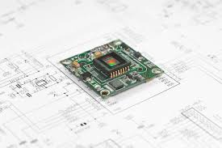
Business Viability
Commercialization
Advanced sensors can be integrated over time
(without altering the core design)
2 segments of target customers
Primary Segment
Secondary Segment
  speech impaired individuals
  paralysis patients with speech failure
  children with speech issues
  individuals with high screen time exposure
  computer vision syndrome
ex- dry electrodes instead of gel based
Diversified Revenue Model
Improved and remote patient monitoring
Partnership with Hospitals/ Healthcare Ind
Non-invasive heart rate & cuffless BP measuring
Sales to opthamologists/ opticians
Adaptable specs' design
  inclusion of next-generation styles
User friendly and affordable wearable device
Direct Sales to end-users (caretakers)
Rechargeable
(extended use and multiple work cycles)
components and sensors can be easily repaired
Sustainable Product
11

Slide 12
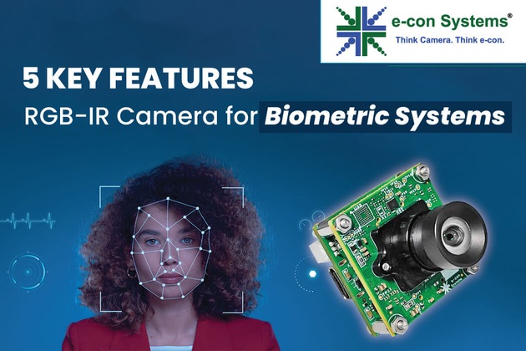
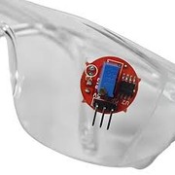
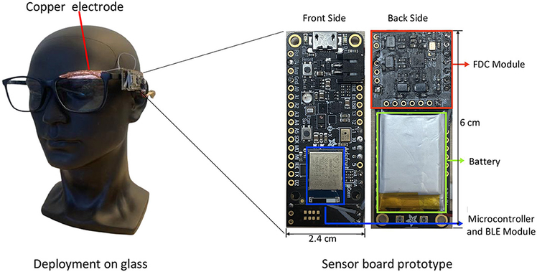
Innovation and Uniqueness
How does LifeBlink solves these challenges?
Current Eye Tracking Methods | Sensors used in Pre-Existing Technologies | Limitations
Video-oculography (VOG) | RGB/ NIR camera | High power consumption and potential ethical concerns regarding continuous monitoring
Infrared Oculography (IROG) | QTR sensor(s) | Harmful IR radiations cause thermal damage to cornea in the long run
Capacitance-based oculography | Capacitive Sensor | Susceptibility to interference from external factors, limiting its usability in various scenarios
EOG Sensors can be modelled as non contact sensors
EOG Sensors can utilize natural gravity based contact of spectacles
Unobstrusive view with additional vital monitoring feature and language conversation ability.
High Privacy and Security over Camera based sensors
Image sources: stemvolt.in
e-Con Systems
frontiersin.org
12

Slide 13
References
1. | https://doi.org/10.1145/3053330
2. | https://www.researchgate.net/publication/319551340_Glabella_Continuously_Sensing_Blood_Pressure_Behavior_using_an_Unobtrusive_Wearable_Device
3. | Energy-efficient, low-latency and non-contact eye detection with Capacitive Sensor
4. | https://ieeexplore.ieee.org/document/7844384
5. | http://dx.doi.org/10.1088/0967-3334/34/9/R47
6. | https://dl.acm.org/doi/10.1145/3314410
7. | https://www.ashaekhope.com/pdf/blink-to-speak-english.pdf
8. | https://www.oneclub.org/awards/theoneshow/-award/33980/blink-to-speak/
9. | https://www.instructables.com/Visualizing-Electrical-Impulses-of-Eyes-EOG-Using-/
10. | https://ieeexplore.ieee.org/document/6376393
11. | https://embedded-lab.com/blog/introducing-easy-pulse-a-diy-photoplethysmographic-sensor-for-measuring-heart-rate/
12. | https://www.researchgate.net/publication/343742648_Research_on_Multi-Order_Anti-Aliasing_Filter_in_Bearing_Profile_Detection
13. | https://github.com/Aliama-Bi/An-Eye-Control-Tetris-Game/tree/master/data/Best-Data
13

